Slide 1
ECHOLOCATION
“TOUCHING WITH SOUND”
“SEEING WITH SOUND”
ED YONG

Slide 2
]
https://upload.wikimedia.org/wikipedia/commons/0/0c/Bat_hanging_upside_down.jpg
Caption

Slide 3
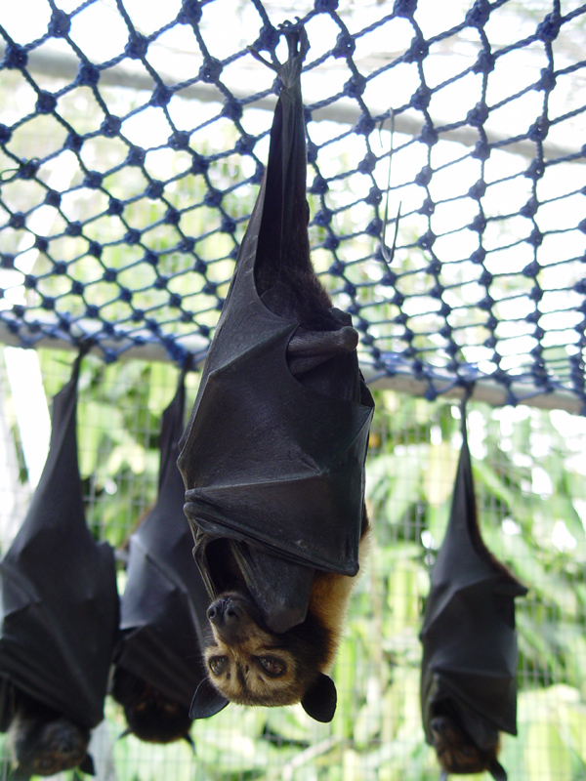
https://upload.wikimedia.org/wikipedia/commons/2/26/Pteropus_conspicillatus.jpg

Slide 7
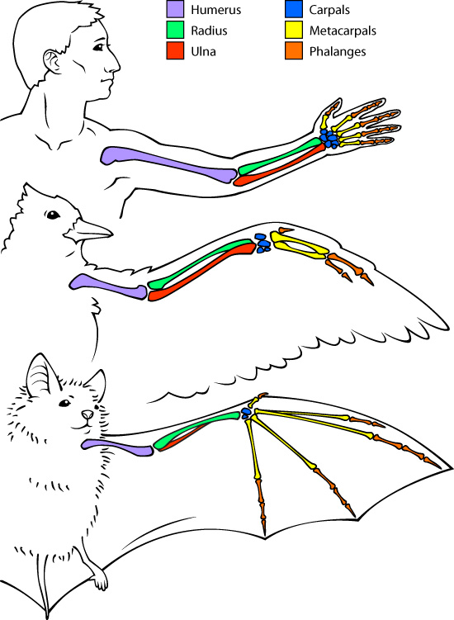

Slide 9
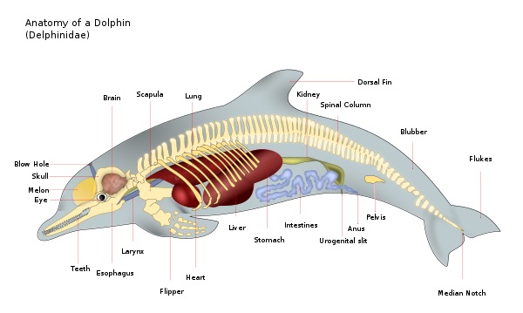
\

Slide 13
